Slide 1
RCSI Hospitals Group Acute Hospital Review Emergency Department
January 2023

Slide 2
Table of Contents
Topic | Slide No.
Executive Summary | 3
Emergency Department
Attendances | 4
Quadrant | 18
PET | 22
Trolleys | 31
2

Slide 3
Executive Summary
KPI | Values | Comments
Monthly Attends | 17,205 | -2 % compared to January 2022
 |  | -2 % YTD
6 Hour PET | 49.1 % | National 6-hour PET: 56.8 %
9 Hour PET | 65.5 % | National 9-hour PET: 72.9 %
PET >= 24 hours | 971 | Equivalent to 5.7 % of all ED departures. National average: 5.3 %
8 AM Trolleys (YTD) | 865 (January) | + 300.5 % compared to January 2022
 | 865 (YTD) | + 300.5 % compared to YTD 2022
3

Slide 4
Emergency Department Attendances
4

Slide 5
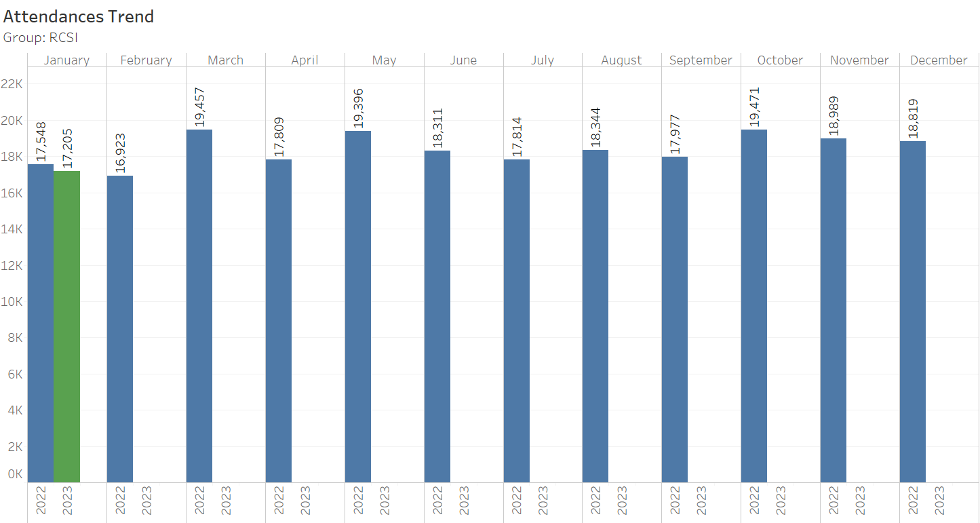
ED Attendances Trend 2023 v 2022
5
Notes:
5

Slide 6
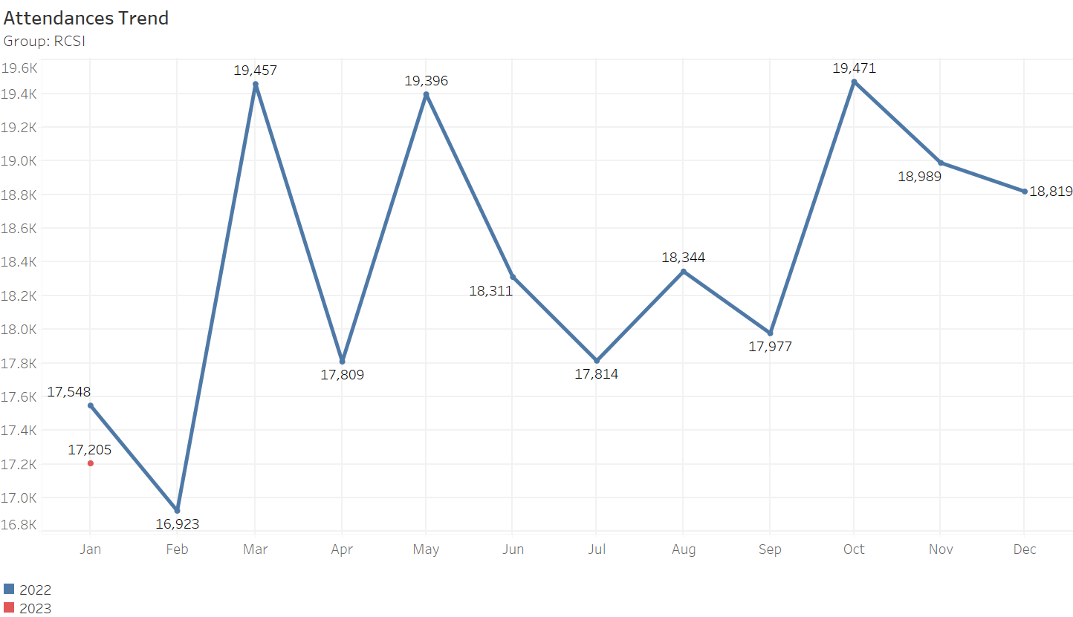
ED Attendances Trend 2023 v 2022
6
Notes:
6

Slide 7
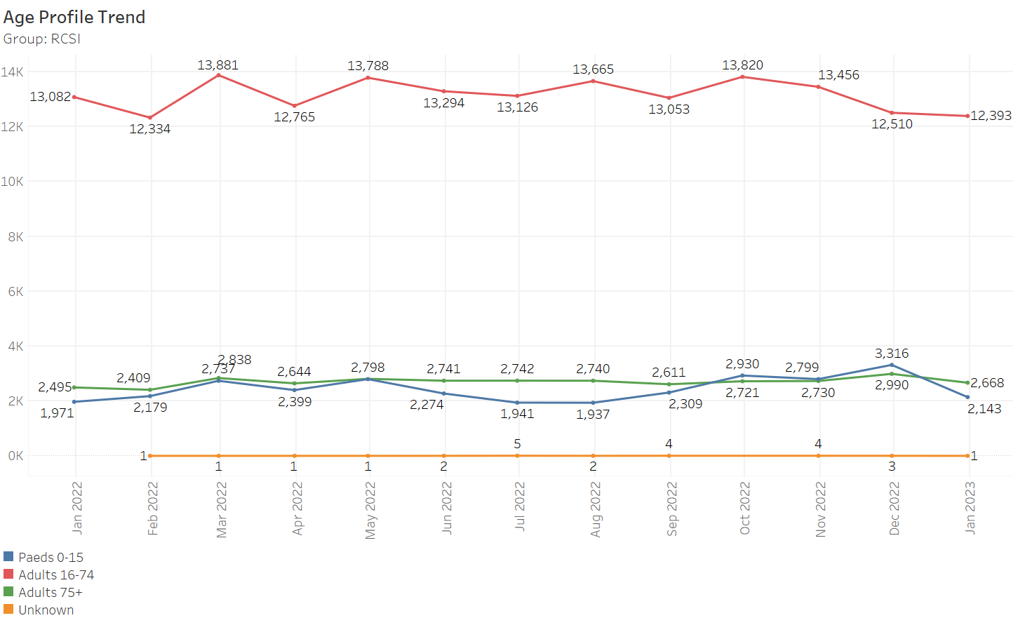
ED Attendances by Age Profile
7

Slide 8
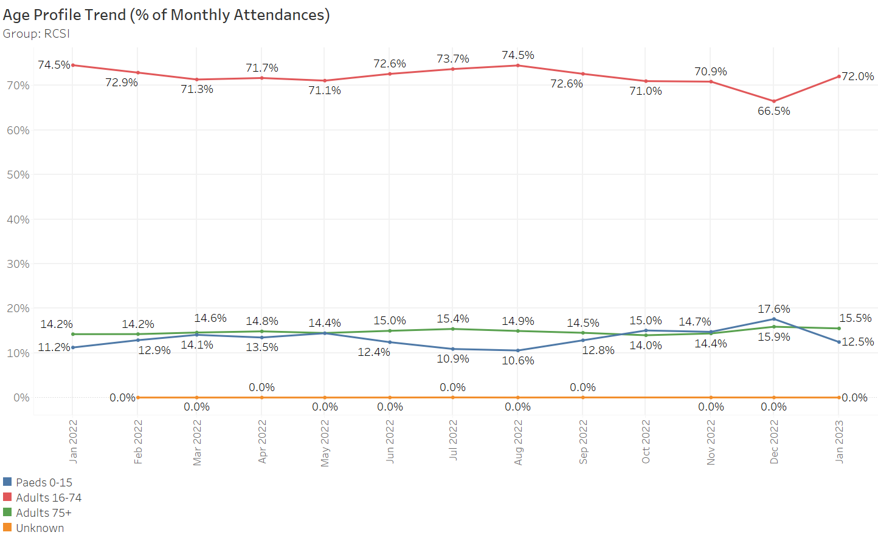
ED Attendances by Age Profile (% of Total)
8

Slide 9
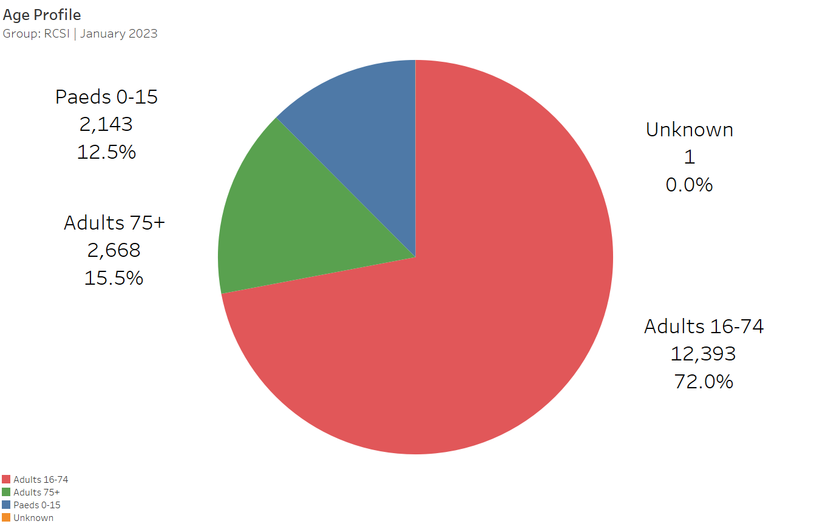
ED Attendances by Age Profile (Pie Chart)
9

Slide 10
ED Attendances & Admissions: Month & YTD Ages: All
ED Attendances
 |  | 2023 |  |  | 2022 |  |  | Difference
Hospital Group | Hospital | January | YTD |  | January | YTD |  | January | YTD
RCSI Hospitals Group | Beaumont | 4,933 | 4,933 |  | 5,180 | 5,180 |  | -4.8% | -4.8%
 | Cavan | 2,819 | 2,819 |  | 2,889 | 2,889 |  | -2.4% | -2.4%
 | Connolly | 4,062 | 4,062 |  | 4,025 | 4,025 |  | +0.9% | +0.9%
 | OLOL | 5,391 | 5,391 |  | 5,454 | 5,454 |  | -1.2% | -1.2%
RCSI Hospitals Group |  | 17,205 | 17,205 |  | 17,548 | 17,548 |  | -2% | -2%
ED Admissions
 |  | 2023 |  |  | 2022 |  |  | Difference
Hospital Group | Hospital | January | YTD |  | January | YTD |  | January | YTD
RCSI Hospitals Group | Beaumont | 1,450 | 1,450 |  | 1,435 | 1,435 |  | +1% | +1%
 | Cavan | 925 | 925 |  | 642 | 642 |  | +44.1% | +44.1%
 | Connolly | 1,137 | 1,137 |  | 1,168 | 1,168 |  | -2.7% | -2.7%
 | OLOL | 2,028 | 2,028 |  | 1,848 | 1,848 |  | +9.7% | +9.7%
RCSI Hospitals Group |  | 5,540 | 5,540 |  | 5,093 | 5,093 |  | +8.8% | +8.8%
10

Slide 11
ED Attendances & Admissions: Month & YTD Ages: 0-15
ED Attendances (Ages:0-15)
 |  | 2023 |  |  | 2022 |  |  | Difference
Hospital Group | Hospital | January | YTD |  | January | YTD |  | January | YTD
RCSI Hospitals Group | Beaumont | 3 | 3 |  | 2 | 2 |  | +50% | +50%
 | Cavan | 700 | 700 |  | 610 | 610 |  | +14.8% | +14.8%
 | Connolly | 4 | 4 |  | 2 | 2 |  | +100% | +100%
 | OLOL | 1,436 | 1,436 |  | 1,357 | 1,357 |  | +5.8% | +5.8%
RCSI Hospitals Group |  | 2,143 | 2,143 |  | 1,971 | 1,971 |  | +8.7% | +8.7%
ED Admissions (Ages:0-15)
 |  | 2023 |  |  | 2022 |  |  | Difference
Hospital Group | Hospital | January | YTD |  | January | YTD |  | January | YTD
RCSI Hospitals Group | Beaumont | 0 | 0 |  | 0 | 0
 | Cavan | 74 | 74 |  | 70 | 70 |  | +5.7% | +5.7%
 | Connolly | 0 | 0 |  | 0 | 0
 | OLOL | 223 | 223 |  | 202 | 202 |  | +10.4% | +10.4%
RCSI Hospitals Group |  | 297 | 297 |  | 272 | 272 |  | +9.2% | +9.2%
11

Slide 12
ED Attendances & Admissions: Month & YTD Ages: 75+
ED Attendances (Ages:75+)
 |  | 2023 |  |  | 2022 |  |  | Difference
Hospital Group | Hospital | January | YTD |  | January | YTD |  | January | YTD
RCSI Hospitals Group | Beaumont | 981 | 981 |  | 898 | 898 |  | +9.2% | +9.2%
 | Cavan | 413 | 413 |  | 413 | 413 |  | +0% | +0%
 | Connolly | 555 | 555 |  | 529 | 529 |  | +4.9% | +4.9%
 | OLOL | 719 | 719 |  | 655 | 655 |  | +9.8% | +9.8%
RCSI Hospitals Group |  | 2,668 | 2,668 |  | 2,495 | 2,495 |  | +6.9% | +6.9%
ED Admissions (Ages:75+)
 |  | 2023 |  |  | 2022 |  |  | Difference
Hospital Group | Hospital | January | YTD |  | January | YTD |  | January | YTD
RCSI Hospitals Group | Beaumont | 546 | 546 |  | 483 | 483 |  | +13% | +13%
 | Cavan | 264 | 264 |  | 211 | 211 |  | +25.1% | +25.1%
 | Connolly | 347 | 347 |  | 343 | 343 |  | +1.2% | +1.2%
 | OLOL | 475 | 475 |  | 418 | 418 |  | +13.6% | +13.6%
RCSI Hospitals Group |  | 1,632 | 1,632 |  | 1,455 | 1,455 |  | +12.2% | +12.2%
12

Slide 13
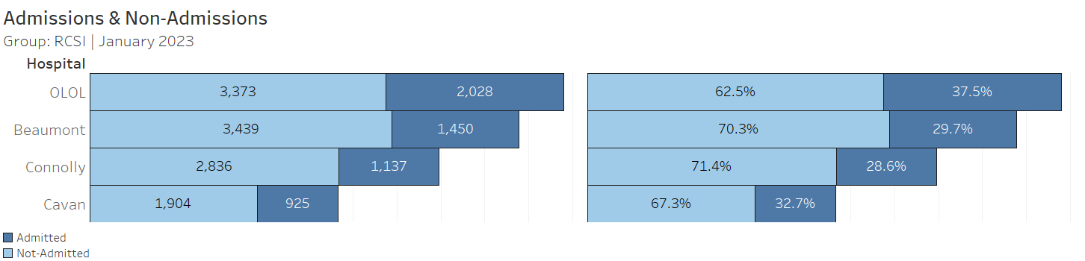
ED Departures By Admission Rate
13

Slide 14
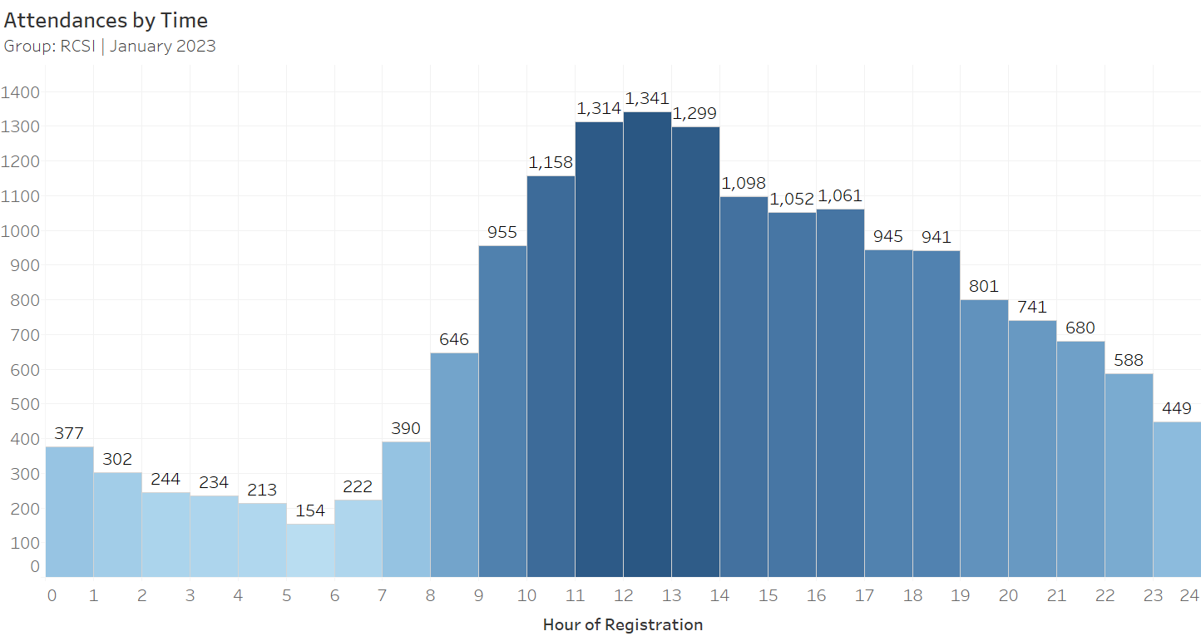
Monthly Attendances By Hour of Registration
14

Slide 15
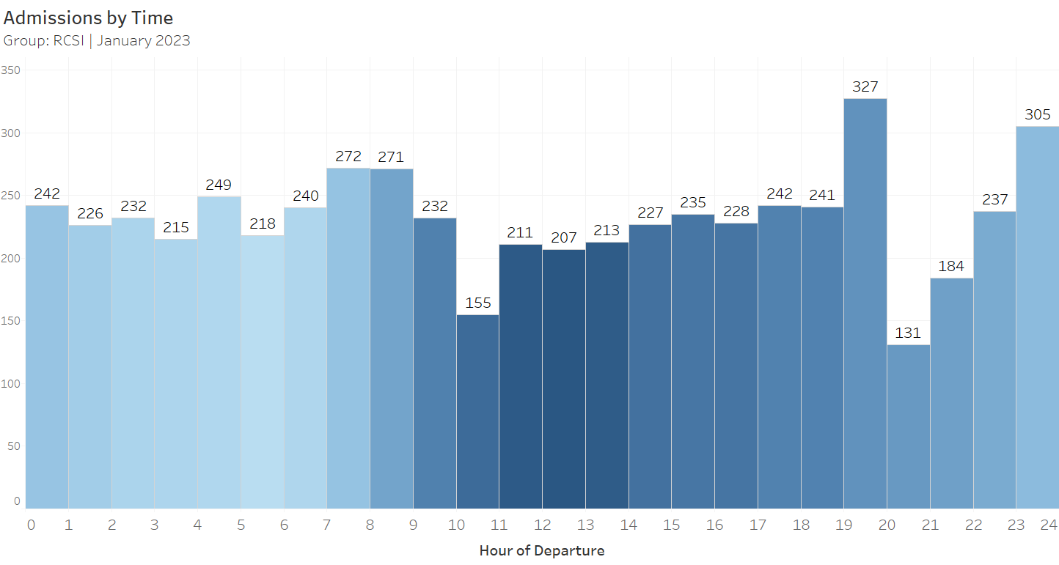
Monthly Admissions By Hour of Departure
15

Slide 16
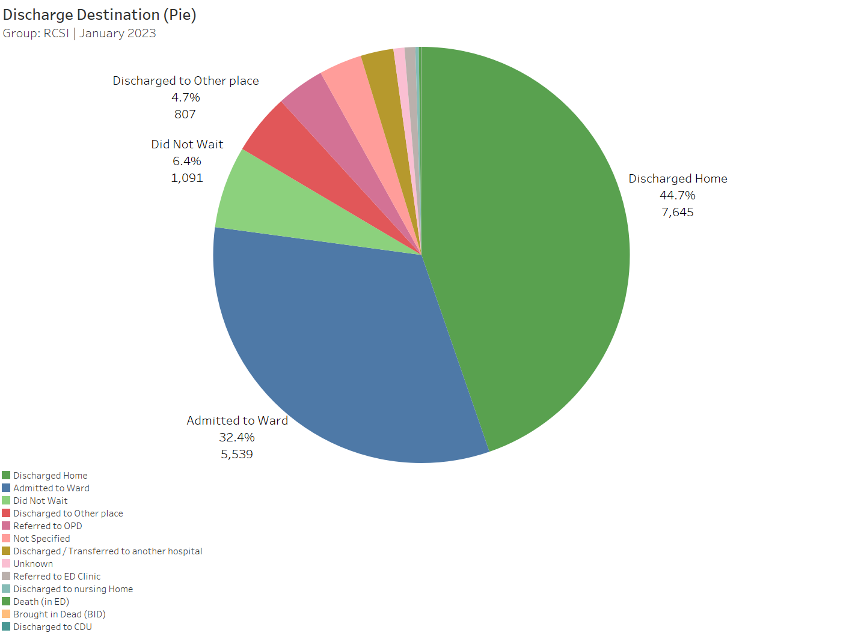
Discharge Destination (Pie Chart)
16

Slide 17
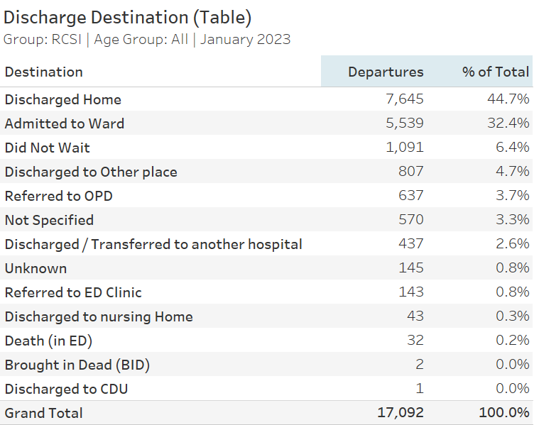
Discharge Destination (Table)
17

Slide 18
Emergency department Quadrant
18

Slide 19

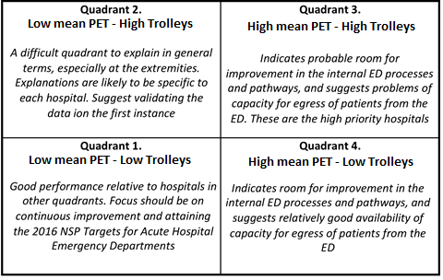
ED Quadrant Analysis & Interpretation
The “Quadrant” is a graphical two-dimensional relative analysis of the acute hospitals offering ED services, where the two dimensions are:
Mean PET
Normalised 8am TrolleyGAR trolley count
The mean PET performance for the period in question is represented by the X-Axis
The Y-Axis is a measure of the 8am TrolleyGAR trolley count per 100 adult attendees at the ED during the period. This “normalised” trolley count is suitable for hospital-to-hospital comparisons
For ease of interpretation, the chart is sub-divided into four quadrants, defined by the median mean PET and the median Trolleys per 100 Adult Attendees.
As a general rule:
Low mean PET and Low Trolleys – GOOD
High mean PET & High Trolleys – BAD
The graphic to the right can be used as guidance to the interpretation of each of the four quadrants.

Slide 20
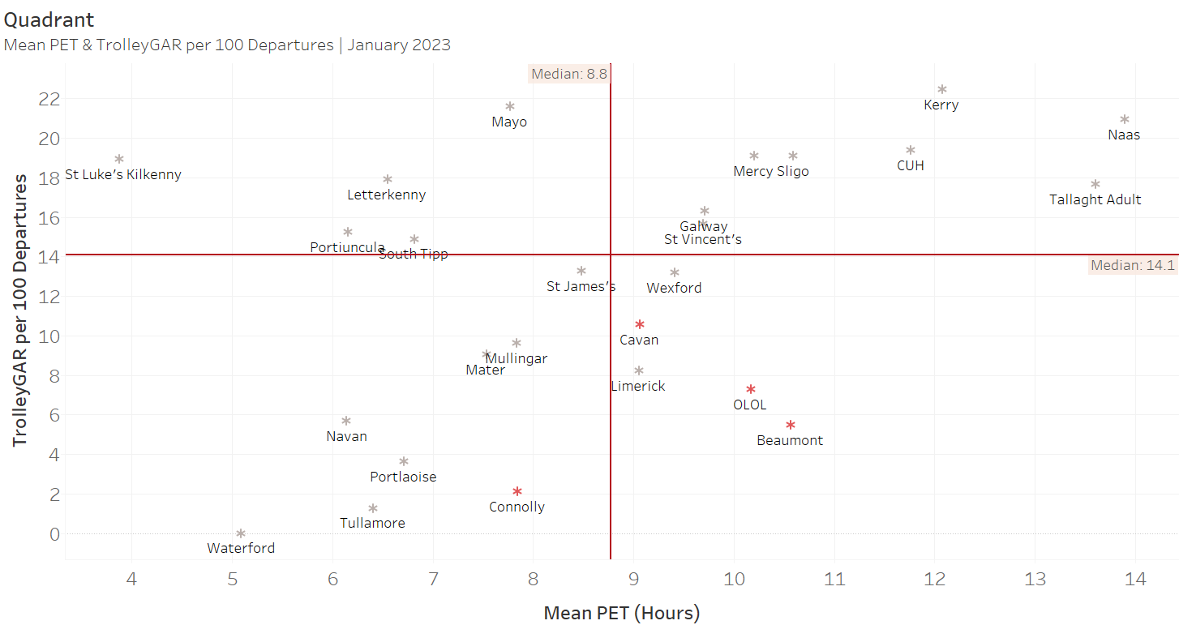
Mean PET & 8AM TrolleyGAR per 100 ED Attends
Note: The mean PET is calculated on the subset of records with an age greater than 15, departing in the reporting month.
20

Slide 21
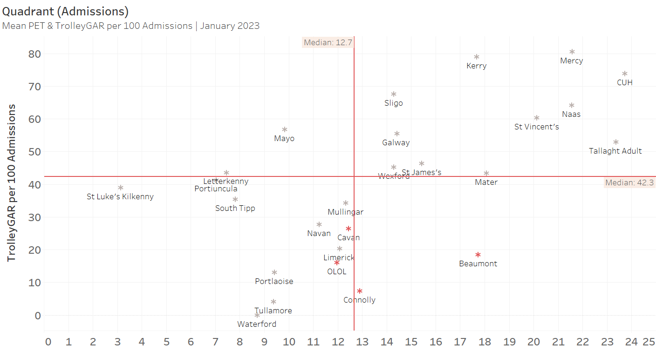
Mean PET & 8AM TrolleyGAR per 100 ED Admissions
Note: The mean PET is calculated on the subset of records with an age greater than 15, admitted in the reporting month.
21

Slide 22
Emergency department PET
22

Slide 23
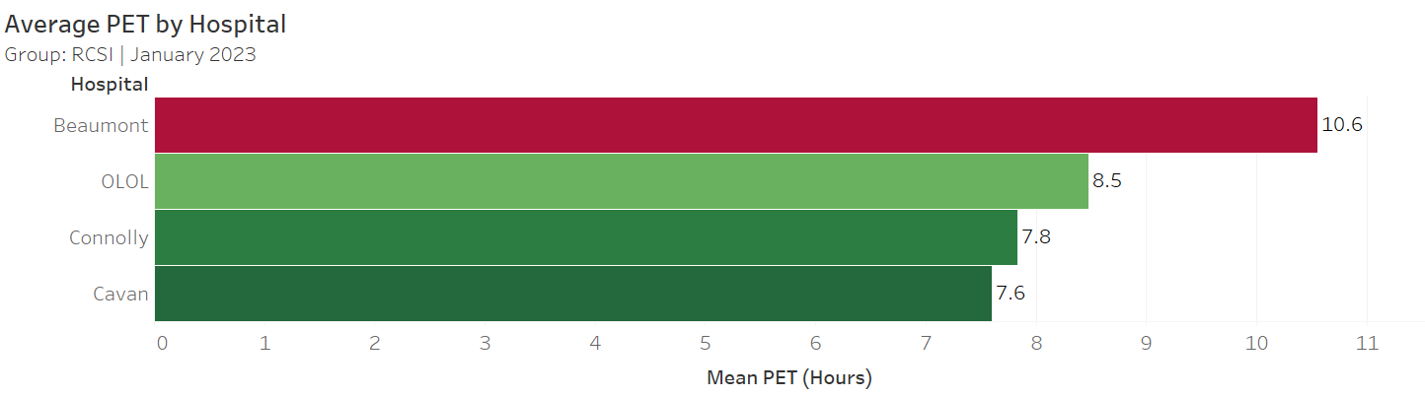
Average PET by Hospital
23

Slide 24
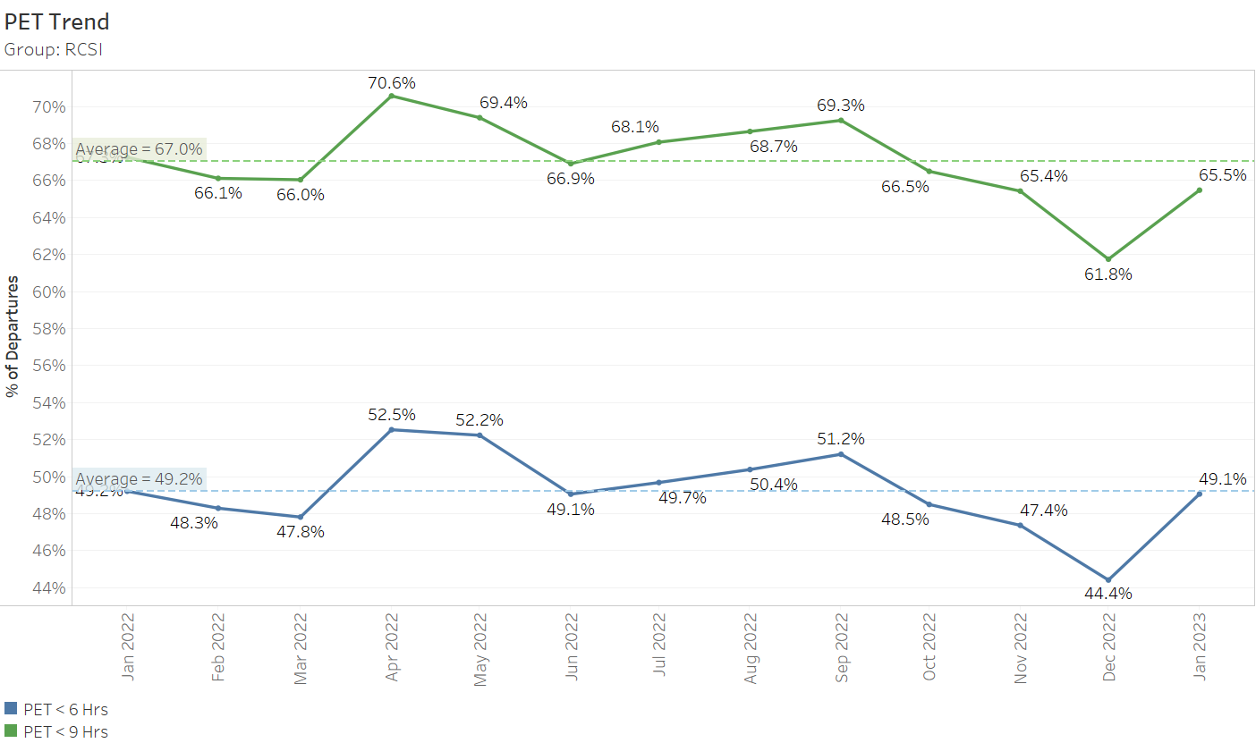
Performance to 6 and 9 Hour PET
24

Slide 25
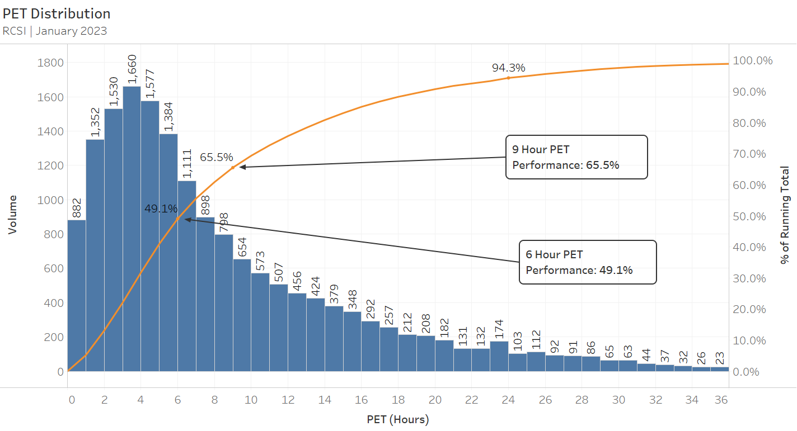
PET Distribution
25

Slide 26
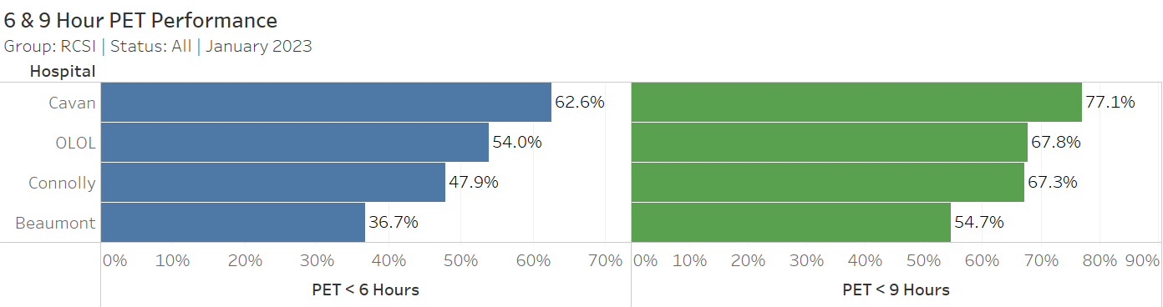
6 & 9 hour PET (All) – Hospital Detail
26

Slide 27
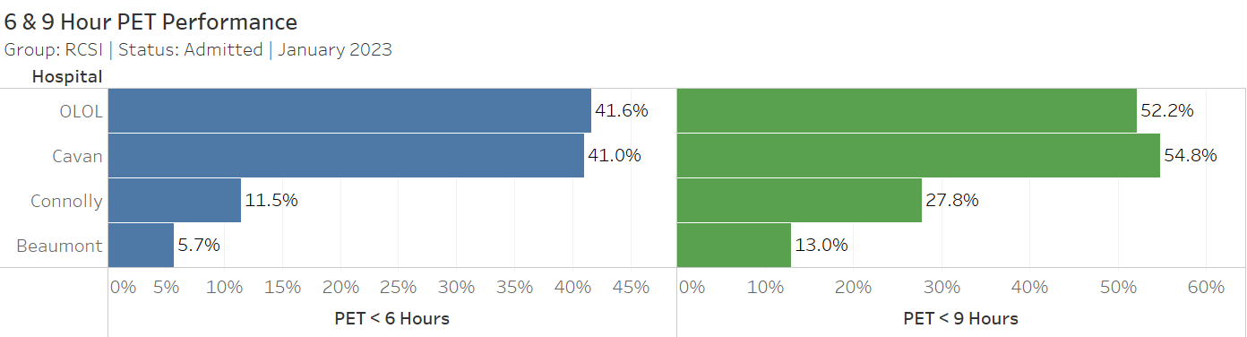
6 & 9 Hour PET (Admitted) – Hospital Detail
27

Slide 28
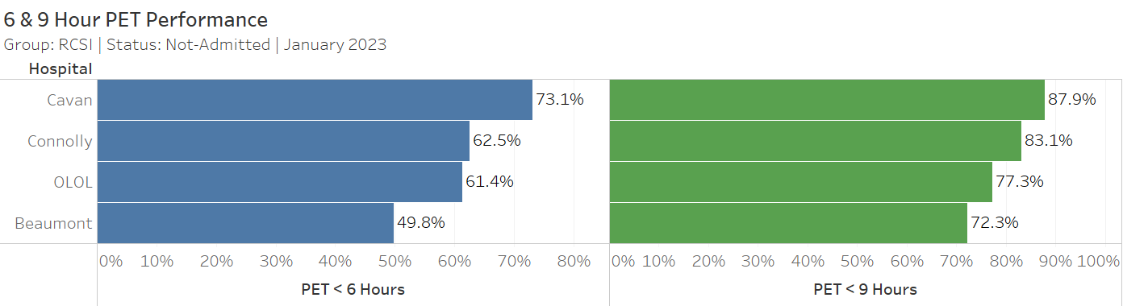
6 & 9 Hour PET (Not-Admitted) – Hospital Detail
28

Slide 29
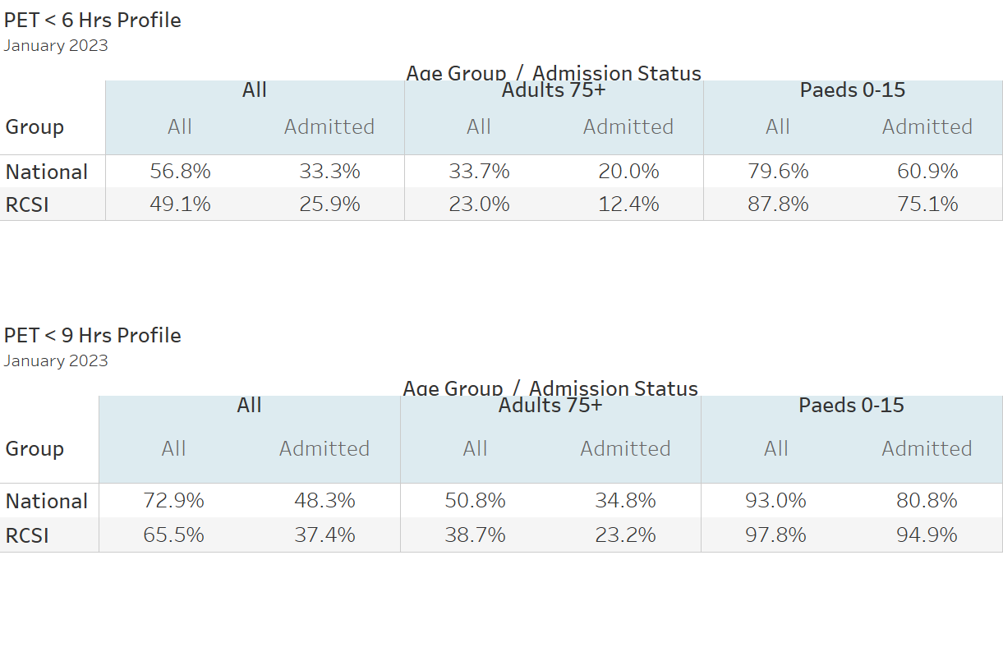
6 & 9 Hour PET by Selected Patient Cohorts
29

Slide 30
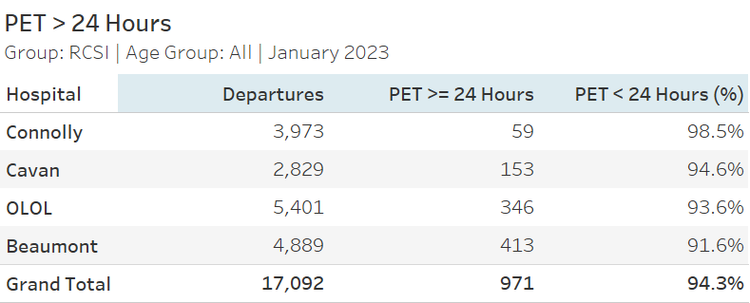
PET Greater Than 24 Hours
30

Slide 31
Emergency department trolleys
31

Slide 32
8AM Trolley Count: Month & YTD 2023 v 2022
8am TrolleyGAR
 |  | 2023 |  |  | 2022 |  |  | Difference
Hospital Group | Hospital | January | YTD |  | January | YTD |  | January | YTD
RCSI Hospitals Group | Beaumont | 267 | 267 |  | 0 | 0
 | Cavan | 225 | 225 |  | 105 | 105 |  | +114.3% | +114.3%
 | Connolly | 84 | 84 |  | 5 | 5 |  | +1580% | +1580%
 | OLOL | 289 | 289 |  | 106 | 106 |  | +172.6% | +172.6%
RCSI Hospitals Group |  | 865 | 865 |  | 216 | 216 |  | +300.5% | +300.5%
32

Slide 33
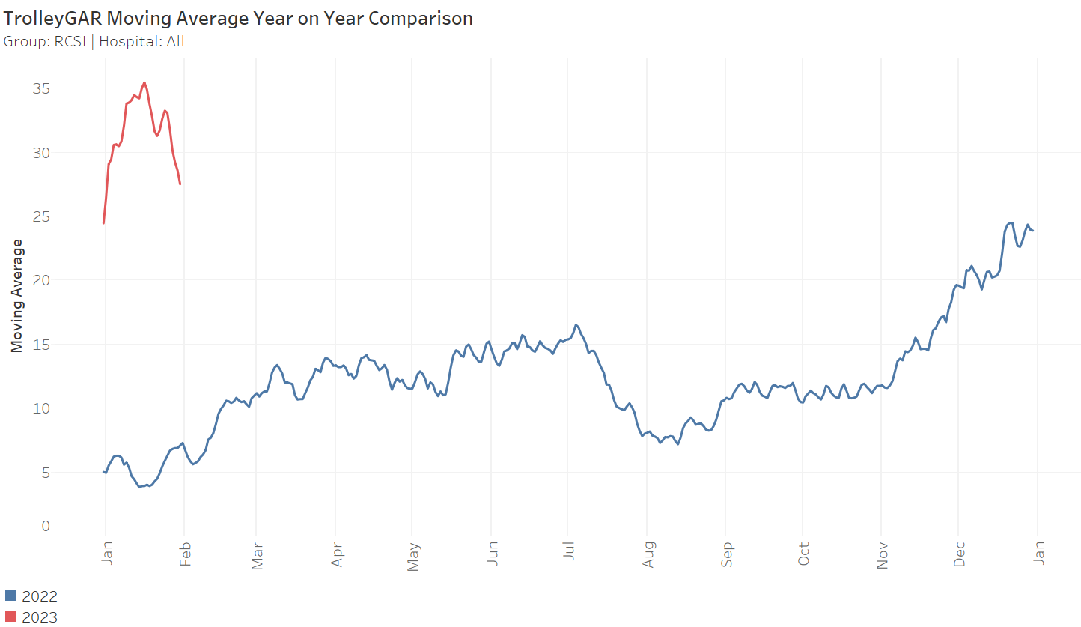
RCSI 30 Day Moving Average 2023 v 2022
33

Slide 34
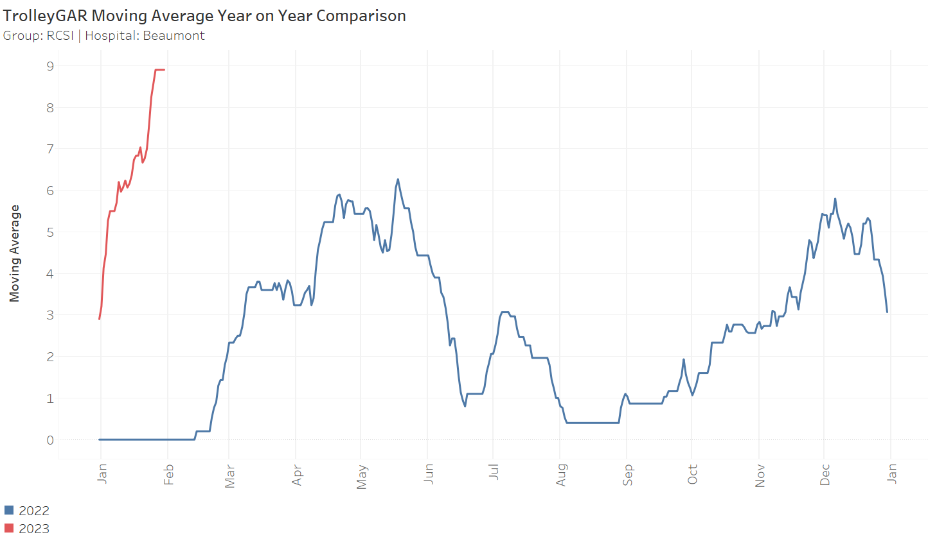
Beaumont 30 Day Moving Average 2023 v 2022
34

Slide 35
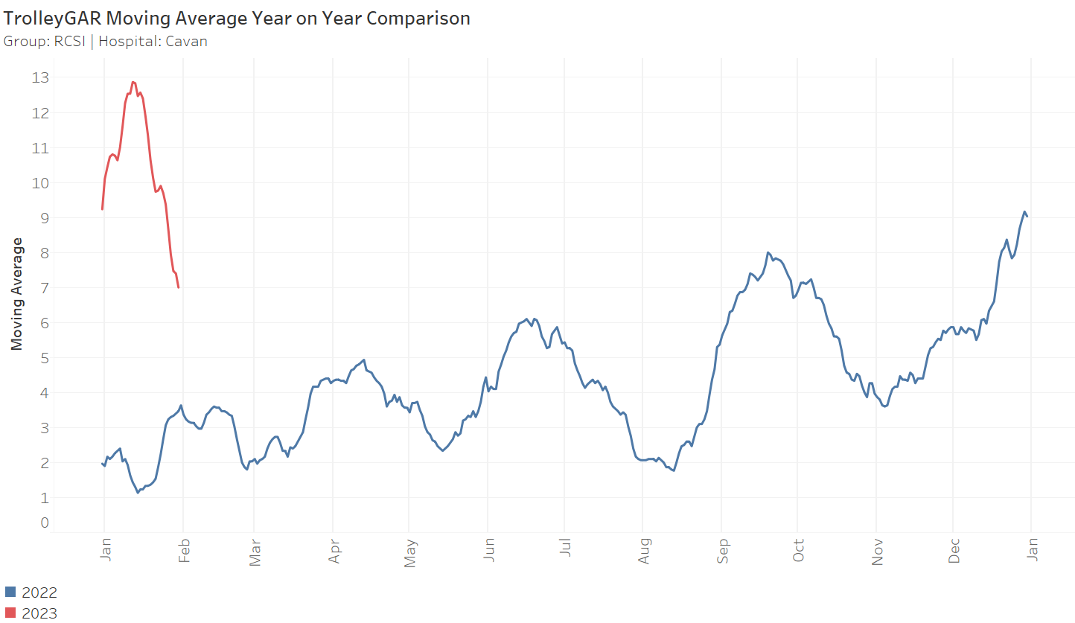
Cavan 30 Day Moving Average 2023 v 2022
35

Slide 36
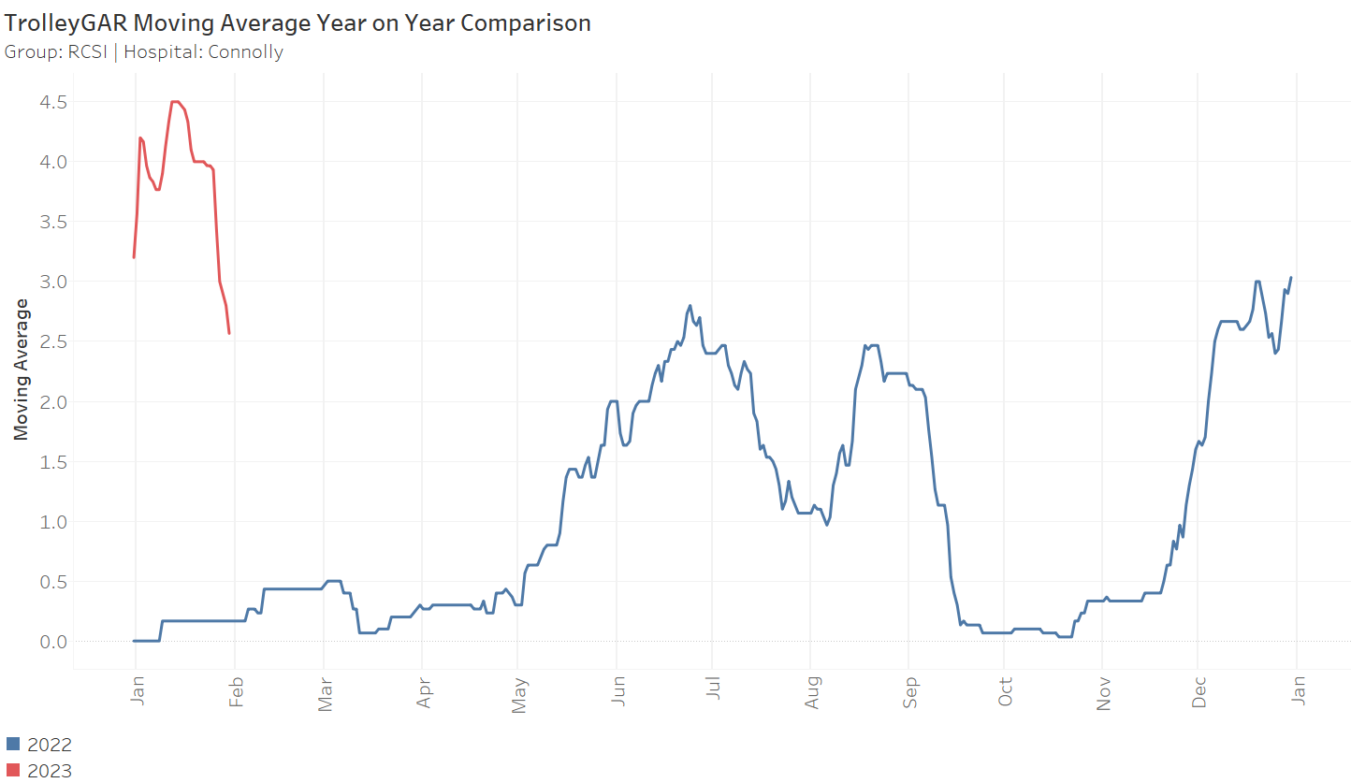
Connolly 30 Day Moving Average 2023 v 2022
36

Slide 37
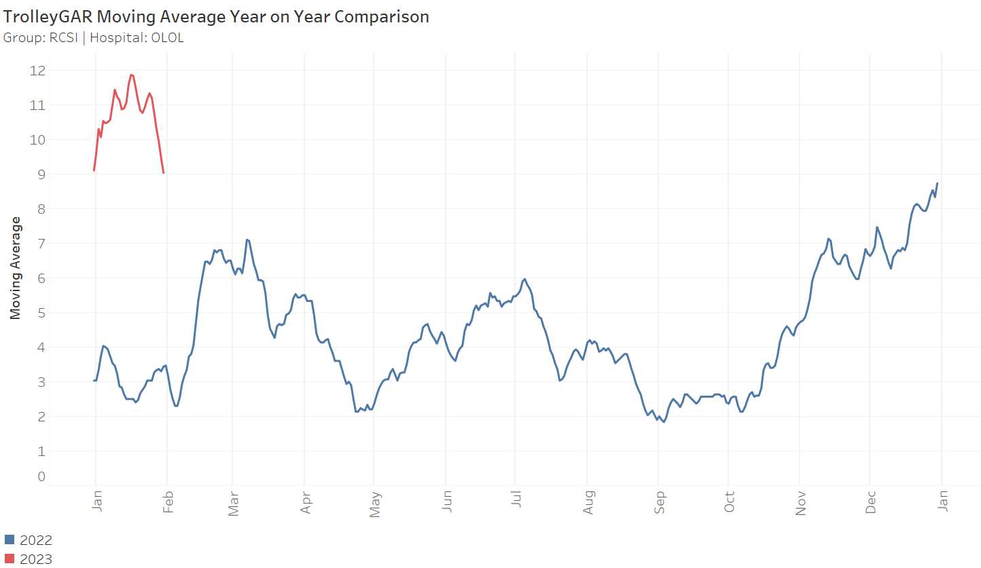
OLOL 30 Day Moving Average 2023 v 2022
37

Slide 38
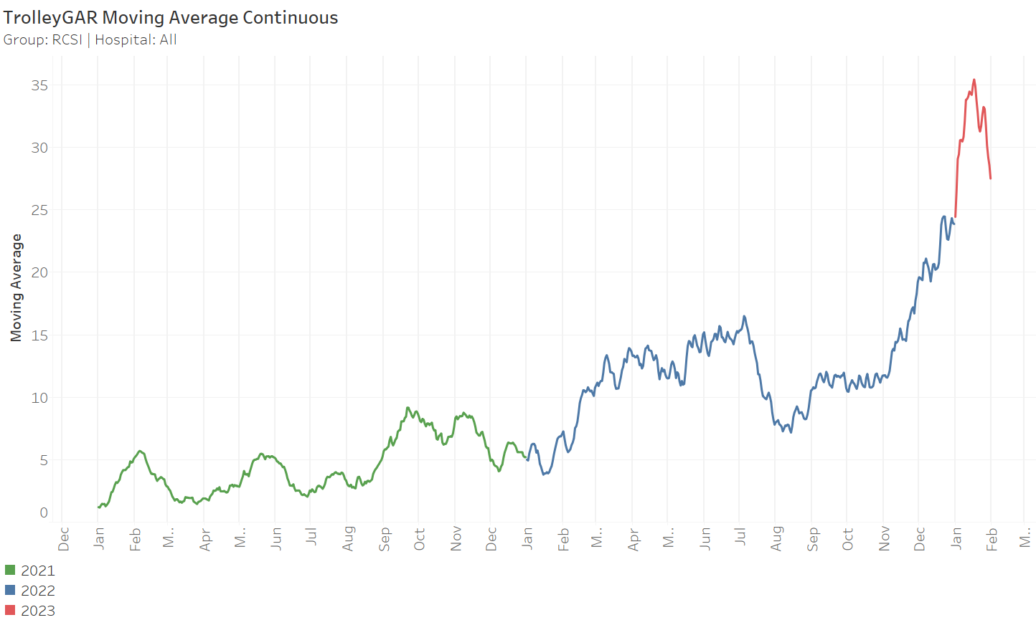
RCSI 30 Day Moving Average 2021 to 2023
38

Slide 39
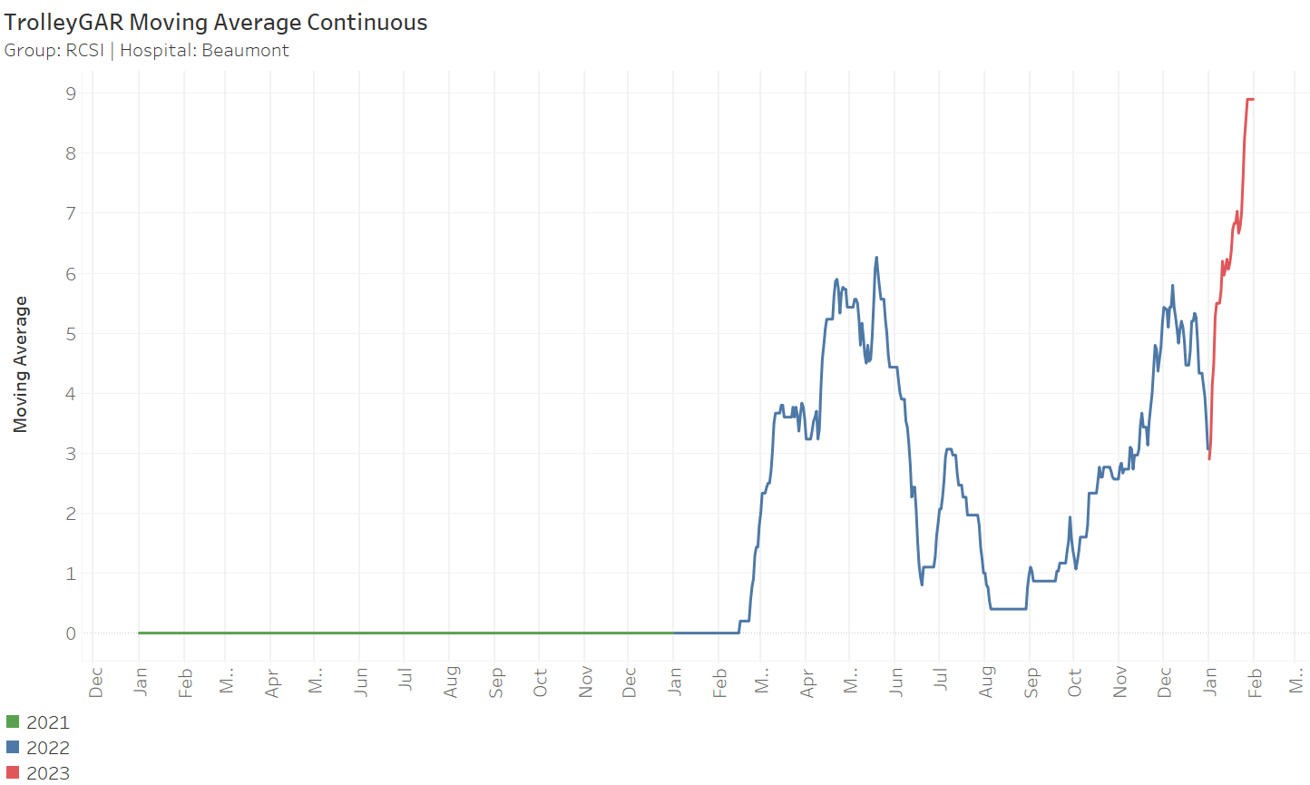
Beaumont 30 Day Moving Average 2021 to 2023
39

Slide 40
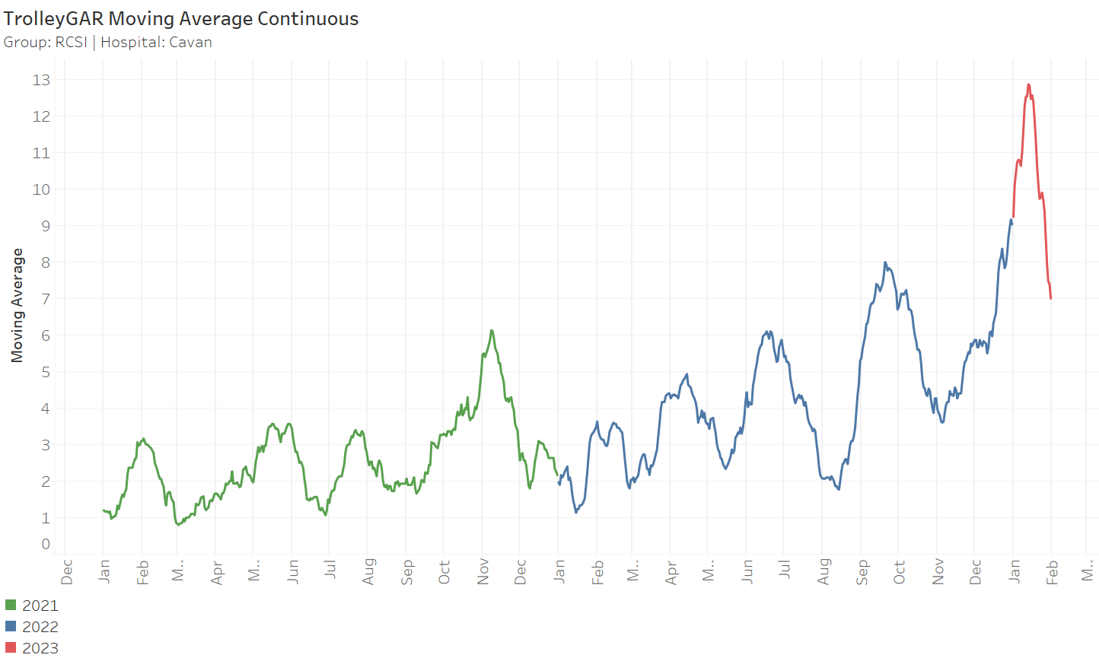
Cavan 30 Day Moving Average 2021 to 2023
40

Slide 41
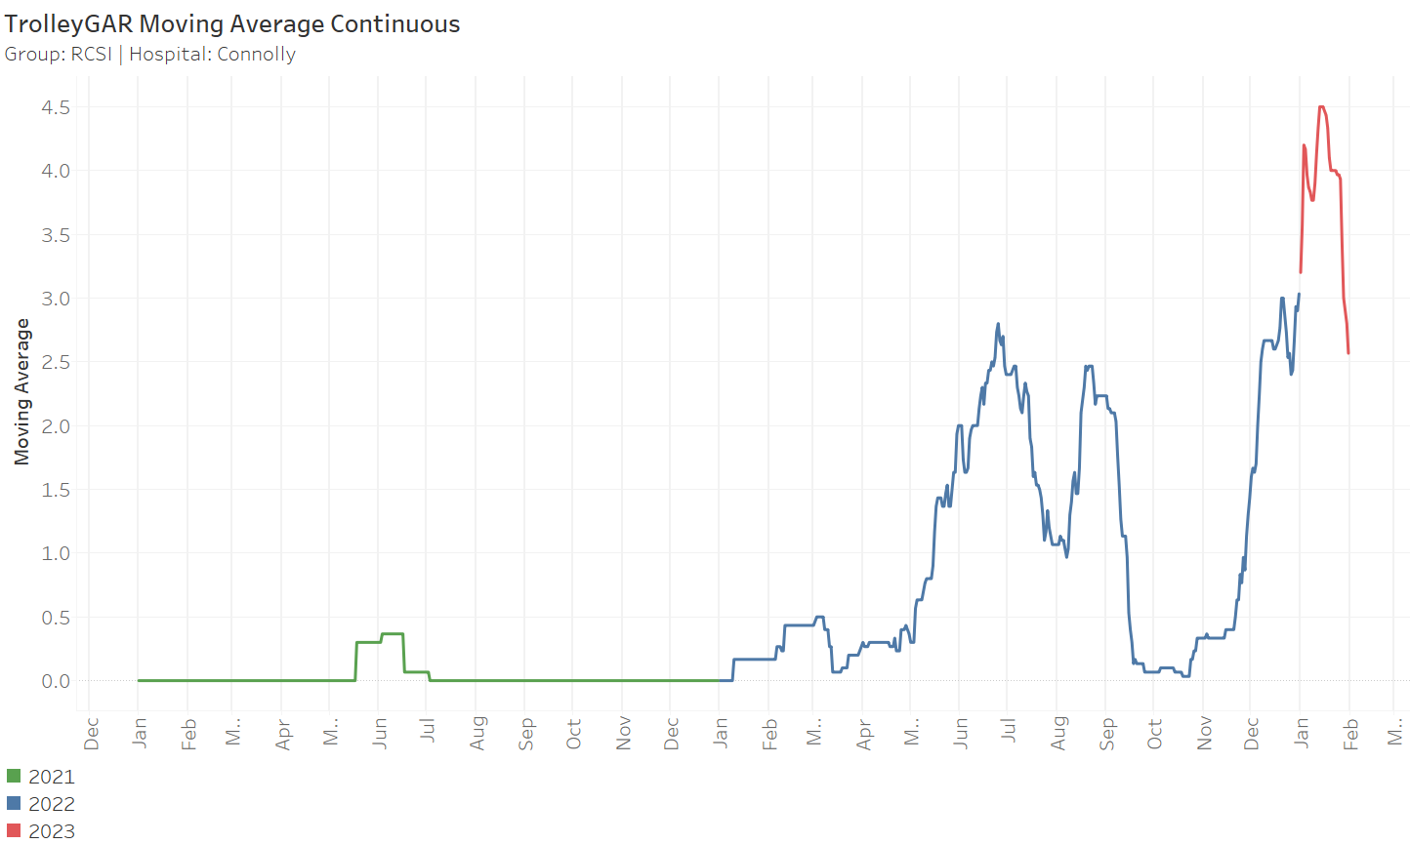
Connolly 30 Day Moving Average 2021 to 2023
41

Slide 42
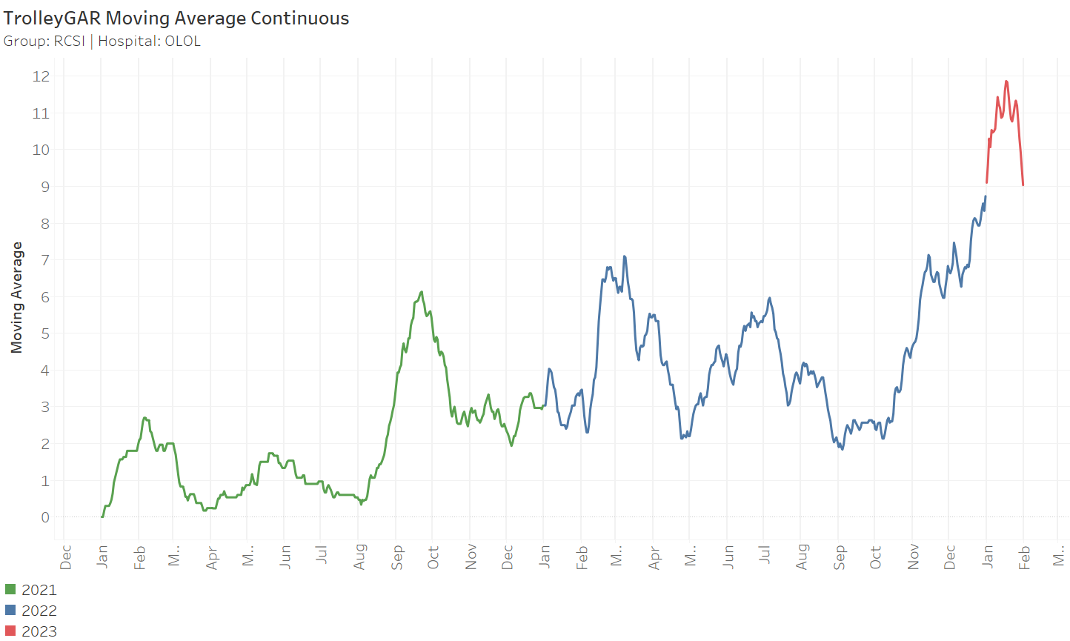
OLOL 30 Day Moving Average 2021 to 2023
42

Slide 43
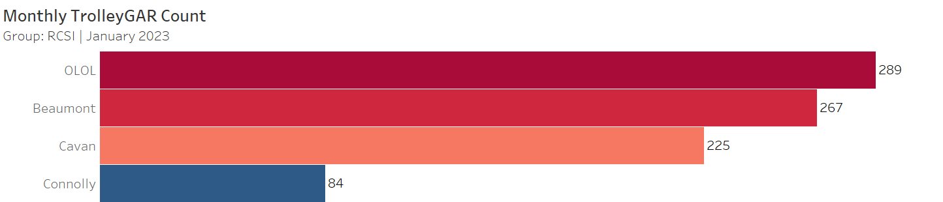
Monthly Trolley Count by Hospital
43

Slide 44
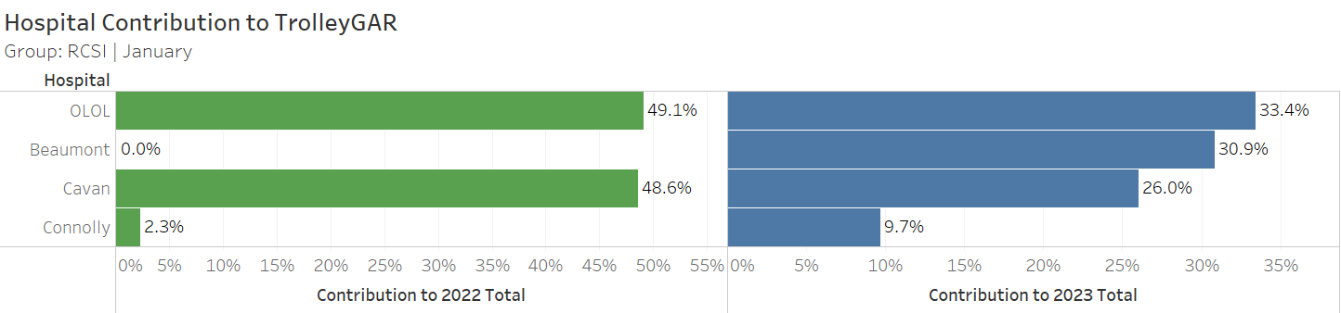
% Trolley Contribution 2023 v 2022
44

Slide 45
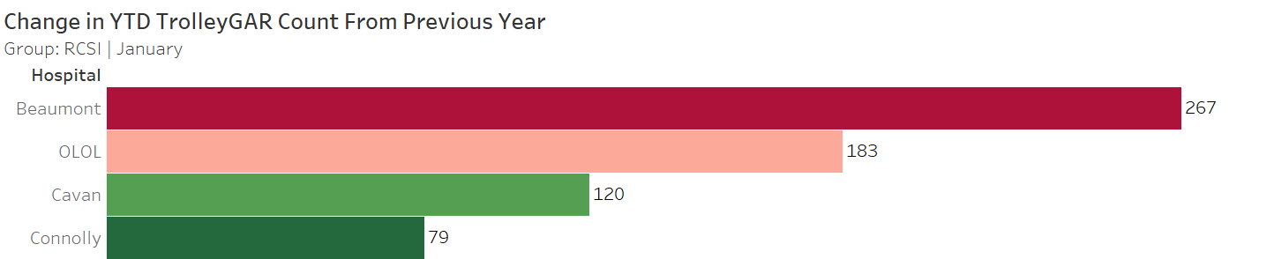
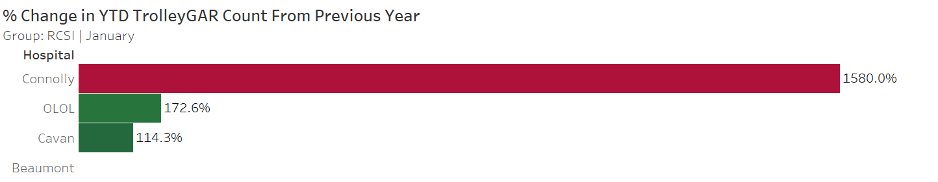
2023 v 2022 Total Change in YTD 8am Trolleys
45

